Slide 1
Annual Training Case Update November 14, 2023
Kyle Applegate, Chief Counsel
https://openrecords.pa.gov
@OpenRecordsPA
openrecords@pa.gov
(717) 346-9903

Slide 2
Reported Opinions

Slide 3
Case Law Update: Electronic video redaction
Cent. Dauphin Sch. Dist. v. Hawkins, 286 A.3d 726 (Pa. 2022)
Because a school bus surveillance video was an education record covered by FERPA, the school district was directed to provide a copy of the video with students’ images redacted.
Each level of court review rejected the school district’s claim that electronic redaction was outside of its capabilities.
The Supreme Court noted “it is clear Section 706 of the RTKL mandates agencies like the District to redact information exempt from disclosure and does not give them discretion in this regard; they are simply required to comply with the law.”
Agencies are required to explain why electronic redaction of video records is impossible.

Slide 4
Case Law Update: Facebook/Social Media
Penncrest Sch. Dist. v. Cagle, 293 A.3d 783 (Pa. Commw. Ct. 2023) (en banc)
Request sought FB posts and FB comments by school board members related to LGBTQ issues following a news article featuring several such posts about one of the school libraries.
OOR applied a test it had used for several years: did the FB page serve as a significant platform for the agency to conduct any official business?
OOR granted access to the records, finding that the school board members made regular use of FB to discuss official business with constituents. The trial court affirmed, reasoning that it “does not matter” whether the FB posts were made on the Board’s FB account or the members’ private FB accounts.

Slide 5
Case Law Update: New Test for Social Media Platforms
The Commonwealth Court disagreed with the trial court’s reasoning, stating that we must “consider the following nonexclusive factors”:
Does the FB page have the “trappings” of an official agency account?
Is it marked public or private?
Also look to the FB page’s contents, not just its appearance or purpose
Does the FB page document a transaction or activity of an agency?
Must review the content of the posts to determine
Was the FB page produced under the agency’s authority or subsequently ratified, adopted, or confirmed by the agency?
Did the agency require or direct the posts?
Did the posts further the agency’s interests?
Ultimately, context is very important to the analysis.

Slide 6
Case Law Update: Facebook/Social Media
Wyoming Borough v. Boyer, 299 A.3d 1079 (Pa. Commw. Ct. 2023) (en banc)
Request sought information concerning the Mayor of the Borough’s FB page
The OOR found that the page was a record of the Borough, noting that it was categorized as a “Public Figure” page; was titled “Joseph Dominick Mayor of Wyoming”; and, most importantly, mostly contained content discussing Borough business.
The trial court reversed the OOR. Citing the Cagle opinion, the Commonwealth Court vacated and remanded back to the trial court for an analysis under Cagle.
However, the Court noted the Mayor used the Facebook page in an official manner, and that mayors have greater authority to bind the agency, ultimately concluding “that case law more strongly supports the disclosure of a borough mayor’s social media activities.”

Slide 7
Case Law Update: Prothonotaries
Scolforo v. County of York, 298 A.3d 193 (Pa. Commw. Ct. 2023)
Request for the names, salary, job titles, and length of service of employees of the York County Prothonotary’s Office. The OOR dismissed the appeal for lack of jurisdiction, reasoning that the Prothonotary is a judicial agency, and that the OOR is unable to grant access to records of a judicial agency.
The Commonwealth Court held that:
Prothonotaries are judicial agencies under the RTKL and their staff are personnel of the Unified Judicial System
Even if possessed by the County, a local agency, the records are judicial records because they document the activities of a judicial agency
Only financial records are available from a judicial agency under the RTKL; however, the information, including length of service, is a financial record

Slide 8
Case Law Update: Narrowly Construed Exemptions
PUC v. Nase, No. 514 C.D. 2022, 2023 Pa. Commw. LEXIS 140 (Pa. Commw. Ct. 2023)
Request for records concerning a water company represented by the Requester. The OOR, after an in camera review, granted the appeal in part.
The Commonwealth Court held that:
The “notes and working papers” exemption, 65 P.S. § 67.708(b)(12), covers those records “retained solely for the convenience of individual officials”
Records used to facilitate the daily activities of a team or working group are not covered under the exemption
Meanwhile, emails between employees exchanging information or containing discussion are not covered by the exemption
Records are not exempt under the internal, predecisional deliberation exemption, 65 P.S. § 67.708(b)(10)(i)(A), simply because they would show that the agency engaged in a deliberation
Records are not protected by the attorney-client privilege simply because they reflect that someone within the agency sought and received legal advice; the records must actually contain privileged information
Exemptions are to be construed narrowly, and agencies must provide sufficient evidence demonstrating how a specific record falls under an exemption.

Slide 9
Case Law Update: Coroner Records
Allegheny County v. Hailer, 298 A.3d 476 (Pa. Commw. Ct. 2023)
Request for autopsy and toxicology reports.
The Coroner’s Act sets fees for certain coroner records. 16 P.S. § 1252-B. The OOR granted the appeal based upon this section, but the trial court reversed, finding this section only permitted disclosure of the records in the event that a nongovernmental agency sought the information for the purpose of investigating an insurance claim or determining liability for the death of the decedent.
However, the Commonwealth Court found that the section does not limit who can obtain the records for the quoted fees. “…[T]he General Assembly intended that coroner records would be publicly accessible, provided the appropriate fee was paid.”

Slide 10
Case Law Update: Retirement v. Discharge
Fruchter v. Borough of Malvern, Nos. 495 C.D. 2022, 496 C.D. 2022; 2023 Pa. Commw. LEXIS 156 (Pa. Commw. Ct. 2023)
Request sought documents referenced in a Retirement Agreement between the Borough and a police sergeant, who was the subject of disciplinary proceedings. The OOR concluded that the documents were contained in the employee’s personnel file and related to employee discipline, and did not constitute the final action resulting in demotion or discharge. 65 P.S. § 67.708(b)(7)(viii). The trial court affirmed, finding that neither the Retirement Agreement nor the documents referenced within effectuated a demotion or discharge.
The Commonwealth Court found that the referenced documents are not necessary to decipher the Retirement Agreement, and noted that the fact that a document is attached or referenced to a document does not subject it to disclosure.
The Court also found that the Retirement Agreement was not the “final action” resulting in the sergeant’s discharge. The Court, noting that “discharge” is not defined by the RTKL, noted that “an employee’s retirement is a voluntary resignation by his own choice, while discharge is typically initiated by his employer.” Thus, a decision to retire by agreement is not a discharge.

Slide 11
Case Law Update: Untimely Appeals from the OOR
Bethke v. City of Philadelphia, 282 A.3d 884 (Pa. Commw. Ct. 2023)
Request sought all policies from the Sheriff’s Office
OOR granted, and the City failed to appeal the Final Determination within 30 days
Requester filed for mandamus, and the Court of Common Pleas directed the City to cross-appeal nunc pro tunc to address security concerns
Commonwealth Court holds that failure to timely appeal the OOR’s Final Determination requires an extraordinary circumstance such as fraud, administrative breakdown, or some other circumstance unrelated to negligence.
“…[I]t is the procedural circumstances, not the merits or perceived importance of the case, that must be extraordinary to warrant relief.”

Slide 12
Unreported Opinions Unreported opinions of the Commonwealth Court are not binding precedent, but may be cited for their persuasive value

Slide 13
Case Law Update: The RTKL provides an adequate statutory remedy
Duquette v. Office of Open Records, No. 84 M.D. 2022 (Pa. Commw. Ct. 2023)
After an OOR Appeals Officer issued a Final Determination, a requester sought mandamus, declaratory, and injunctive relief against the OOR concerning issues that arose during the appeal before the OOR.
The Commonwealth Court granted the OOR’s preliminary objections, finding that the requester’s claims “stem from the [OOR’s] issuance of its Final Determination,” and that the requester “could have obtained such relief by appealing the Final Determination to common pleas.” This relief is adequate, as the RTKL provides requesters with a right to a de novo appeal. Therefore, the Court found that there was an adequate statutory remedy.

Slide 14
Case Law Update: Sufficiency of evidence
Mack v. Pa. Dep’t of Corrections, No. 699 C.D. 2022 (Pa. Commw. Ct. 2023)
Request sought (in part) a financial record; agency argued that it does not exist.
On appeal, AORO submitted an affidavit explaining that another employee was “likely” to have such records but had confirmed that she did not.
The Commonwealth Court held that this language was insufficiently certain to find that the records don’t exist. The Court in this instance took issue with the use of the word “likely” and noted that the fact that the agency located another record after claiming it did not exist should have “alerted” the OOR to question the veracity of the agency’s evidence.

Slide 15
Case Law Update: Severance payments
Allegheny County Airport Auth. v. Belko, No. 117 C.D. 2023
Request for severance payments made to former Authority employees.
Past public expenditures are no different than current public expenditures, such as salaries, and there is no expectation of privacy in one’s receipt of public funds.
The Court, quoting a prior Supreme Court case: “…[A]ny person desiring to keep his or her name and ‘relevant financial data’ private ‘should refuse Commonwealth disbursements…. The public has a right to know how the Commonwealth spends its money.’”
Therefore, the constitutional right to privacy did not apply.

Slide 16
Case Law Update: Mug Shots
In re Mezzacappa, No. 1229 C.D. 2021
Request for mug shots taken at the County prison. Mug shots are not prohibited from being disclosed under the Criminal History Record Information Act (“CHRIA”), and are not exempt under the RTKL’s investigative exemptions.

Slide 17
Case Law Update: What is an agency?
Pysher v. Clinton Twp. Volunteer Fire Co., No. 766 C.D. 2022 (May 24, 2023) (unreported)
Request for various financial records, payments, loans, meeting minutes, etc.
The Fire Co. denied the Request, arguing that it was not a government agency under the RTKL. This case applied the test previously set forth by the Commonwealth Court in an earlier Pysher opinion, 209 A.3d 1116, to determine that.

Slide 18
Case Law Update: What is an agency?
Prior case established a three part test:
How much control does gov’t have?
How much public money?
Does it have a governmental purpose?
The OOR applied this test and found that the Fire Co. was not an agency.
Court of Common Pleas reversed, persuaded that the combination of the Fire Co.’s essential governmental function and large volume of public funds made it an agency.

Slide 19
Case Law Update: What is an agency?
Commonwealth Court endorses the lower court’s application of the test.
Emphasizes the public function of the Fire Co. and the fact that the majority of its money was from municipal contracts. The Fire Co. admitted that it “would cease to exist” without government financial support.
Although the municipalities did not formally appoint most of its members, they nevertheless had significant power to audit or curtail the Fire Co.

Slide 20
OOR Case Law Index
Can be found at https://www.openrecords.pa.gov/Documents/RTKL/RTKL_Case_Index.pdf
Final Determinations as well as subsequent case law can be located on the OOR’s dockets at: https://www.openrecords.pa.gov/Appeals/DocketSearch.cfm

Slide 21
Specificity and the RTKL

Slide 22
Specificity
Disclaimers
This presentation is not legal advice and not binding authority
Definitive answers may not always exist – reasonable minds may differ
Facts of each individual case are very important – case by case analysis
Goal
To give you some tips and discuss the legal factors and three-part test used by OOR and the courts in determining whether a request is sufficiently specific
To give you the tools to apply the relevant test factors and reach a reasonable conclusion or draft a reasonable request that is specific
To give you additional resources

Slide 23
General Observations
Use common sense
Be polite
Don’t unnecessarily complicate the process

Slide 24
Purpose of Specificity
Section 703: A written request should identify or describe the records sought with sufficient specificity to enable the agency to ascertain which records are being requested and shall include the name and address to which the agency should address its response
Purpose of specificity – Do you know what they are requesting – what records/information do they want

Slide 25
General Observations
Burdensome (volume) does not equate to insufficiently specific – but may be a factor
A request may be sufficiently specific even though it requests broad categories of records

Slide 26
General Observations
Use of the word “all” does not render automatically insufficiently specific
“but not limited to” and “any and all” – do raise specificity questions
A request can be partially specific
Records can be given without waving the lack of specificity argument
Example: Any and all records, files, or manual(s), communication(s) of any kind…[related to vehicle stops]."
Manual(s) is only part that is specific
Pa. State Police v. Office of Open Records, 995 A.2d 515, 516 (Pa. Commw. Ct. 2010)

Slide 27
Danger of Only Arguing Specificity
Caution: If you rely completely on a lack of specificity argument and you are overruled, you will likely waive any ability to raise exemptions.
The fact that there might be protected information buried in the amassed emails was insufficient. Agency should have ascertained the emails’ status as records and reviewed them for the presence of exemptions and protected information. Consequently, it is simply too late to seek redaction of the emails or to argue that any of them do not constitute records subject to disclosure.

Slide 28
The Three-Part Test
Three-part balancing test
Dept. of Education v. Pitt. Post Gazette, 119 A.3d 1121 (Pa.Cmwlth. 2015)
Request: all of the emails of the Acting Secretary of Education as they pertain to the performance of her duties as Acting Secretary since she was appointed on Aug. 23, 2013 to date (Aug. 5, 2014)
Subject matter
Must identify the transaction or activity of the agency for which the record is sought
Should provide a context to narrow the search
Scope of documents
Must identify a discrete group of documents either by type or recipient
Timeframe for which records sought (most fluid of 3)
Should identify a finite period of time

Slide 29
Subject Matter
Describes a transaction, incident, activity, event, topic, action or other agency business that is contained in, discussed in, or relates to the records you are requesting
An open-ended request that gives an agency little guidance regarding what to look for may be so burdensome that it will be considered overly broad
Specificity must be construed in the request’s context rather than envisioning everything that the request might conceivably encompass example
There are no judgments to be made as to whether the documents are 'related' to the request

Slide 30
Scope
The request should explain the specific type or kind of records you are requesting. (e.g., e-mails, reports, formal decisions, video footage, etc.)
The request should seek records by naming the recipient(s) and/or sender(s). (where possible)

Slide 31
Timeframe
The request should identify a finite period of time.
If that finite period of time is lengthy, does the rest of the request allow the agency to identify the specific records/information you are requesting?
If there is no timeframe, does the rest of the request give enough detail to allow the agency to identify the specific records/information you are requesting?
How much time is too broad? Depends on the facts.
Baxter does not stand for the proposition that a RTKL request that is limited to a short timeframe is always, by itself, sufficiently specific. Keystone Nursing & Rehab. of Reading, LLC v. Simmons-Ritchie (Pa. Cmwlth., Nos. 1631, 1692, and 1696 C.D. 2018, filed January 3, 2020), appeal denied, (Pa., No. 167 MAL 2020, filed September 16, 2021), slip op. at 40.

Slide 32
Specificity: Keywords
Keywords usually add more confusion than clarity
OOR encourages Requesters not to use them
The fact that a request uses keywords in place of a subject matter is not necessarily fatal to the request, but broad keywords alone do not provide a sufficient limiting context. See Montgomery County v. Iverson, 50 A.3d 281, 284 (Pa. Commw. Ct. 2012) ("incredibly broad" search terms do not provide a limiting subject matter)
The OOR has found keyword lists specific where they relate to well-known matters of agency business and the request identifies senders and recipients.
The OOR has previously found that a request for a keyword search where the keywords do not reasonably involve some business of an agency, over the course of nineteen months, was insufficiently specific.

Slide 33
Technology and Keyword Searches
Agency – do you know how to correctly and accurately run searches?
Outlook
Excel
PDF
Online emails
Text messages
Word
Windows
Cloud

Slide 34
Case Law: Specificity
Borough of Pottstown v. Suber-Aponte, 202 A.3d 173 (Pa. Commw. Ct. 2019) | police video footage [(footage)] on October 4, 2015 of herself . . . from the time [she was] brought in [to the police department (Department)] and all activity at [the Department] that day. | Specific? Yes | Why? - The Request clearly identifies the subject matter of the request (Department activity and Requester), the scope of records sought (video surveillance footage) and a specific timeframe (October 4, 2015 - a single day) - Moreover, the Borough's denial clearly reflects the Borough's knowledge of which footage would be responsive to the Request

Slide 35
Case Law: Specificity
OIG v. Brown, 152 A.3d 369 (Pa. Commw. Ct. 2016) | Request: OIG’s rules, regulations, policies or related authority that governs its duties and functions, that were specifically designed by the OIG | Specific? No | Why not? - The Request does not provide any context by which it can be narrowed. No subject matter identified. No category or type of OIG activity, duty, function, or transaction - Is basically for authorities that govern all OIG activity. This also calls for a legal conclusion or interpretation. - Unreasonable burden to require OIG to examine all its rules, regulations, and policies and related authority without knowing with sufficient specificity what OIG business or activity the request contemplates

Slide 36
Case Law: Specificity
DOC v. ABC 27 St. Hilaire, 128 A.3d 859 (Pa. Commw. Ct. 2015) | All records that document inmate injuries/deaths from January 2009 through December 2014. I would also like all records that document employee injuries/deaths while on the job from January 2009 through December 2014. | Specific? Yes | Did not use the three part balancing test but same basic elements - The request sufficiently informs the agency of the records requested - This is a clearly defined set of documents – i.e. records that document inmate injuries a specific subject for the period from January 2009 through December 2014 a specific time period - Burdensome does not deem a request overbroad

Slide 37
Case Law: Specificity
Philly DA v. Bagwell, 155 A.3d 1119 (Pa. Commw. Ct. 2017) | All e-mails, letters and memos pertaining to the [District Attorney’s] transition from Lotus Notes e-mail platform to the Microsoft Exchange e-mail platform between January 1, 2013 and December 31, 2013 | Specific? Yes | (great discussion on specificity with relevant cases) - Seeks a clearly defined universe of documents - Defined the scope by the type of documents sought - Timeframe is finite.

Slide 38
Case Law: Specificity and Context
Carey v. DOC, 61 A.3d 367 (Pa. Commw. Ct. 2013) | Transfers were from 2008 - 2012 2. All documents/ communications which may indicate the individual[s] or agencies who authorized said transfers. | Specific?Yes | All of the records are specified by subject matter and a finite timeframe (date-2008-2012) Part 2 – “All documents/ communications which may” is vague but coupled with the fact that the transfer is well known to DOC, it is sufficiently specific

Slide 39
Case Law: Specificity
Dept. of Education v. Pitt. Post Gazette (Legere), 50 A.3d 265 (Pa. Commw. Ct. 2012) | (Request was filed on September 6, 2011) Determination letters issued since January 1, 2008 as well as orders to well operators in relation to determination letters as described in 208 of Gas Act | Specific? Yes | Specific types of documents requested (letters and orders) Clearly defined universe of documents No judgments as to whether documents are related Agency provided some records goes toward specificity Burdensome does not equate to not specific – but may be a factor Agency's method of tracking, cataloguing, storing and organizing its record that prevents easily retrieval should not be held against the requester

Slide 40
Case Law: Specificity and Keywords
Montgomery County v. Iverson, 50 A.3d 284 (Pa. Commw. Ct. 2012) | Pursuant to section 102 of the Commonwealth of Pennsylvania's Right-to-Know law, I am requesting an electronic copy of all email records to and from the <montcopa.org> mail domain, to and from the <septa.org>, <dvrpc.org>, <pahouse.net[#x3ec] and <pasenate.com> domains, WHERE The email subject and body contain the following terms: A long list of terms was included | Specific? No | Open ended request that gives little guidance MAY be so burdensome that it will be considered overly broad A request may be sufficiently specific even though it requests broad categories of records Specificity must be construed in the requests context rather than envisioning everything that the request might conceivably encompass Did not have timeframe, did not identify individuals, email addresses or even departments

Slide 41
Case Law: Specificity
Office of the Governor v. Engelkemier, 148 A.3d 522 (Pa. Commw. Ct. 2016) | All emails sent or received by Chief of Staff Katie McGinty from January 20, 2015 to present [July 7, 2015]. Office sought clarification Requester provided 109 subject matter key words :2015-2016 Budget, Senate Republicans, Gift Ban, White house, Cape Cod, etc. | Specific? Yes | Two of three factors met (time and scope) - Finite timeframe - Scope limited to emails sent or received by McGinty Although keyword list is lengthy and in some respects broad, in consideration of the narrower timeframe and scope of records and agency response upon receipt of keyword list, request is specific. Keyword list is not necessarily a substitute for a properly defined subject matter. Agency continued processing request after receiving the keywords and should have raised any specificity concerns at that time.

Slide 42
Case Law: Specificity
Easton Area Sch. Dist. v. Baxter, 35 A.3d 1259 (Pa. Cmwlth) (finding request for all emails sent or received by any school board member in thirty-day period to be sufficiently specific because of short timeframe), appeal denied, 617 Pa. 641, 54 A.3d 350 (Pa. 2012)
Mollick v. Twp. of Worcester, 32 A.3d 859 (Pa. Cmwlth. 2011) (concluding request for emails "regarding any Township business and/or activities" insufficiently specific because it "fail[ed] to specify what category or type of Township business or activity" for which information was sought).

Slide 43
Tips for Requesters
Requester
Don’t go on a fishing expedition – use a fishing pole not a net
Be realistic in what you request
I want all records or records related to everything the agency does.
I want records that show agency violated the law
Be willing to work with agency
Is it better to file a second more specific request
Don’t make discovery requests

Slide 44
Tips for Agencies
Agency
Avoid using specificity as a license to deny
Avoid Wordsmithing
When interpreting a RTKL request, agencies should rely on the common meaning of words and phrases, as the RTKL is remedial legislation that must be interpreted to maximize access.
Example: The terms “…presentations and attachments” are “undefined” and “ambiguous.” OOR: Given the widely understood meaning of presentation and attachment = specific
Avoid exaggerating size of request to claim overburdensome
A chain of 25 emails with 25 different people copied is not 625 emails – it is 25 emails

Slide 45
Specificity Worksheet
The Commonwealth Court has developed a balancing test to help determine whether a request is sufficiently specific. The request must have at least two of these and should have all three: a subject matter, scope, and timeframe. Every request is reviewed on a case-by-case basis. The following does not constitute legal advice or binding policy and is only intended to provide helpful questions to assist in drafting a request.
Wording and approaches to avoid:
Avoid using problematic phrases like: - including but not limited to - any and all
Avoid using overly long timeframes: e.g. “All records, files, and emails from 2021-2022”
Avoid using just a list of keywords

Slide 46
Specificity Worksheet
The request should have a subject matter
Does the request describe a transaction, incident, activity, event, topic, action or other agency business that is contained or discussed in the records you are requesting?
Does the request explain how that transaction, incident, activity, event, topic, action or agency business relates to the records/information you are trying to request?
Does the request seek a clearly defined universe (group) of documents?
The request should have a proper scope
Does the request explain the specific type or kind of records you are requesting? (e.g., e-mails, reports, formal decisions, video footage, etc.)
Does the request seek records by naming the recipient(s) and/or sender(s)?

Slide 47
Specificity Worksheet
The request should have a timeframe
Does the request identify a finite period of time?
If that finite period of time is lengthy, does the rest of the request allow the agency to identify the specific records/information you are requesting?
If there is no timeframe, does the rest of the request give enough detail to allow the agency to identify the specific records/information you are requesting?
Additional note:
Answer any clarifying questions the agency may have about the request.

Slide 48
Additional Resources
OOR Docket Search – find an OOR appeal like yours
https://www.openrecords.pa.gov/Appeals/DocketSearch.cfm
Case Law – many court cases listed here
https://www.openrecords.pa.gov/Documents/RTKL/RTKL_Case_Index.pdf
Webinar Trainings
https://www.openrecords.pa.gov/RTKL/TrainingPresentations.cfm
https://www.openrecords.pa.gov/RTKL/TrainingVideos.cfm#web
OOR FAQs
https://www.openrecords.pa.gov/RTKL/About.cfm
How to file a request
https://www.openrecords.pa.gov/RTKL/HowToFile.cfm
How to file an appeal
https://www.openrecords.pa.gov/Appeals/HowToFile.cfm

Slide 49
E-File Appeal Portal

Slide 50
E-File Appeal Portal (E-File Portal)
What is it?
User-friendly online docketing and records management system designed to automate and streamline the RTKL appeal process.
Excluding in camera records and mediation, all elements of the appeal process will be conducted in this secure location.
How does it work?
Requesters use an online form to file an appeal and supporting documents.
Agencies and requesters use the E-File Portal to file evidence, arguments, and to communicate with the Appeals Officer.
A username and password are required to access the E-File Portal. Sharing is possible but not recommended.
Users can track all appeals they are involved in by viewing a list of all active appeals it has pending before the OOR.

Slide 51
E-File Appeal Portal (E-File Portal)
Is there user assistance?
A step-by-step user guide is available and OOR staff are available to assist you with any technical difficulties you may encounter as you use the E-File Portal.
Other advantages?
Agency solicitors and requester representatives can quickly and easily file an Entry of Appearance and third parties can request Direct Interest Participant access. See links below.
Links that make it easy for parties to file and promptly view legal arguments, briefs, memos, affidavits, and other submissions.
Parties receive email notifications when new documents have been added to a specific appeal within the E-File Portal.
Entry of Appearance: https://www.openrecords.pa.gov/Appeals/EntryOfAppearance.cfm
Direct Interest Participant Request: https://www.openrecords.pa.gov/Appeals/DIPRequest.cfm

Slide 52
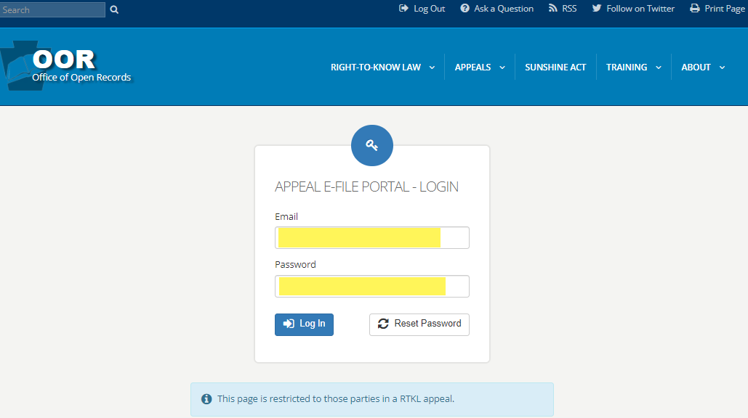
Logging in to E-File Portal
Once you have been granted login credentials you have the option to change your password.
If you don’t remember your password later in the appeal process, you can also reset it.
Notes:
When you are served with a Notice of Appeal in a matter assigned to E-File Portal, you will receive login credentials to enable you to access the appeal docket through the E-File Portal. The credentials will consist of your email address and a password.
Your login credentials will remain the same for all subsequent RTKL appeals that you are involved with.

Slide 53
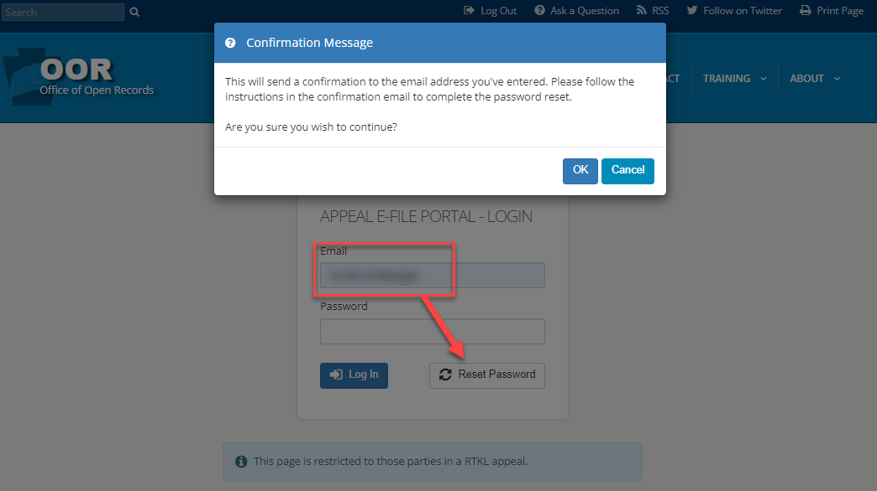
Resetting a Password
Notes:
Once you have been granted login credentials you have the option to change your password.
If you don’t remember your password later in the appeal process, you can also reset it.

Slide 54
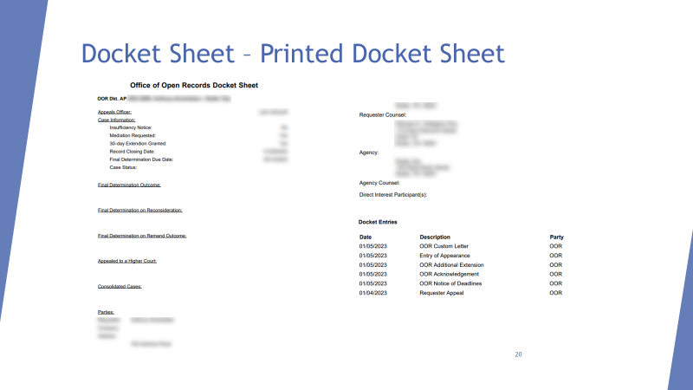
APPEAL DOCKETS
Printable docket sheets for each appeal contain a quick summary of the important information relevant to the appeal.
All of your appeals are listed and are accessible when you login to the E-File Portal. This will be the case whether you have one appeal or multiple appeals.

Slide 55
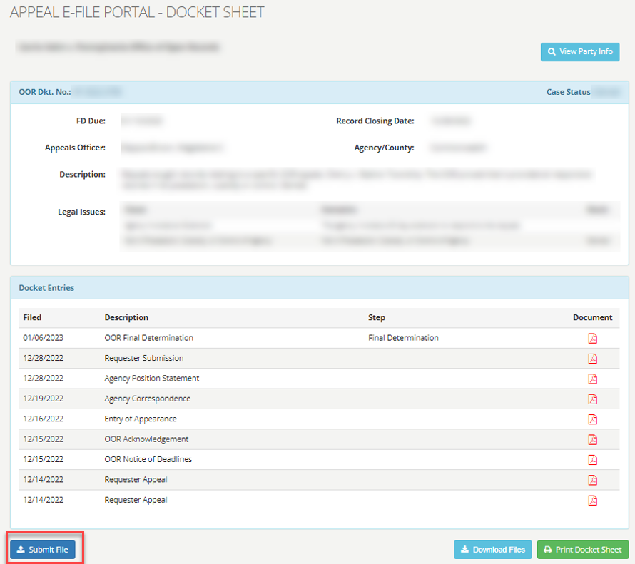
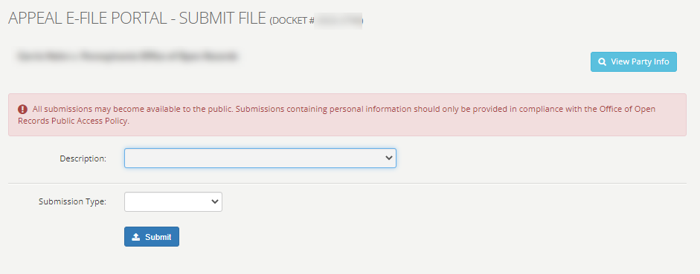
Submit File from Docket Sheet
Notes:
These 4 slides go through the steps for a user to upload documents to the Portal.
This slide depicts the view when a user presses the “Submit File” button on the docket view page.

Slide 56
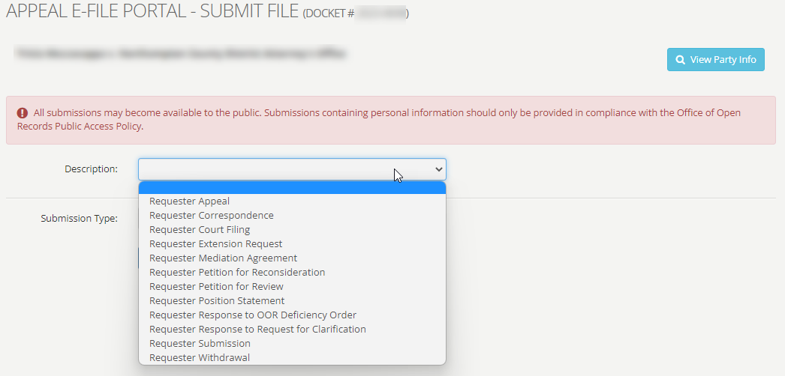
Submit File – Requester Description Choices
Notes:
This slide depicts the Requester’s view of the document upload page.
The drop-down menu provides the user with document descriptions for uploading purposes, i.e. Requester Correspondence or Requester Submission.
Choose the description that best describes your document. If it is an incorrect description, the Appeals Officer can change the description to the correct name.

Slide 57
Submitting Files
Notes:
Please take note of the file limitations and formats that can be accepted through the E-File Portal.
The limitations are highlighted on the slide in the box above “Submit”.
If you have problems or questions, contact the OOR staff at openrecords@pa.gov or 717-346-9903.
In addition, short and more informal correspondence may be sent through the E-File Portal by way of a “Manual Text” box. Using “Manual Text” is similar to sending an email or a text message.

Slide 58
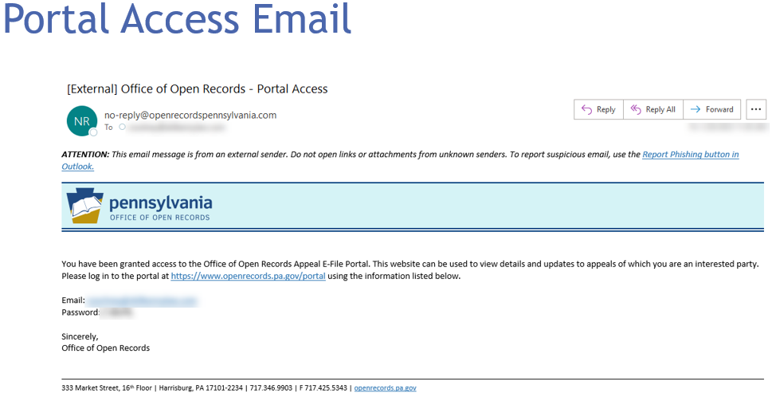
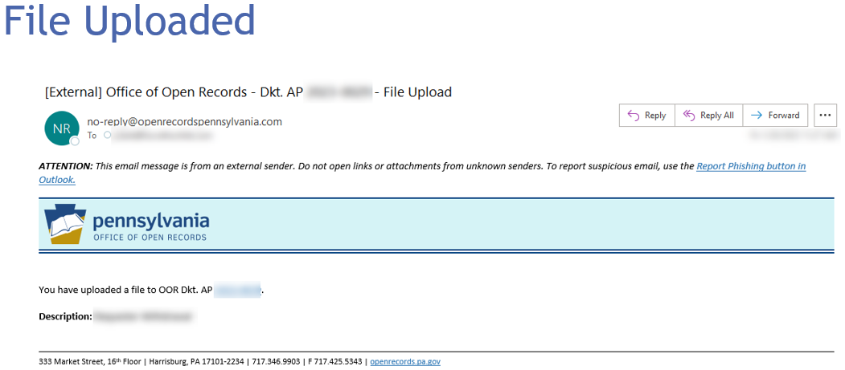
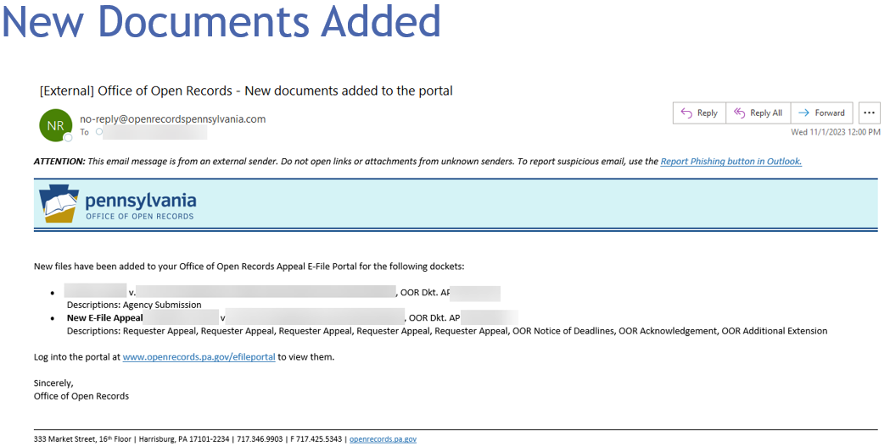
Only the parties to an individual appeal are able to view the docket and uploaded materials.
The Final Determination and post Final Determination documents will be public.
The E-File Portal refreshes once an hour.
You will not immediately receive an email notification confirming your submission or upload.
New Appeals and Documents
You will receive an email notification when new documents have been added to an appeal docket.

Slide 59
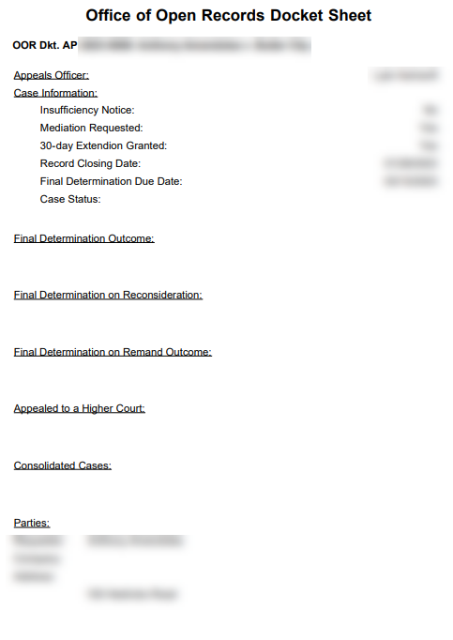
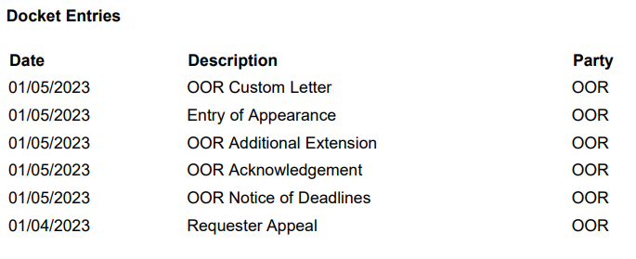
Docket Sheet – Printed Docket Sheet
Notes:
This slide shows an example of the printed docket sheet.
This view shows the appeal case information, party information, as well as dates and descriptions of individual docket entries.

